Slide 1

Robotisation
Robotisation = applying fixed pitch onto a sound
Implemented by setting DFT phase values to 0 before reconstruction
Forces periodicity: erratic and random variations converted into fixed-pitch sound
Pitch determined by hop size between segments
Can even be adjusted dynamically to create pitch changes
“Robot voice” effect
Sound examples: before and after robotisation

Slide 2
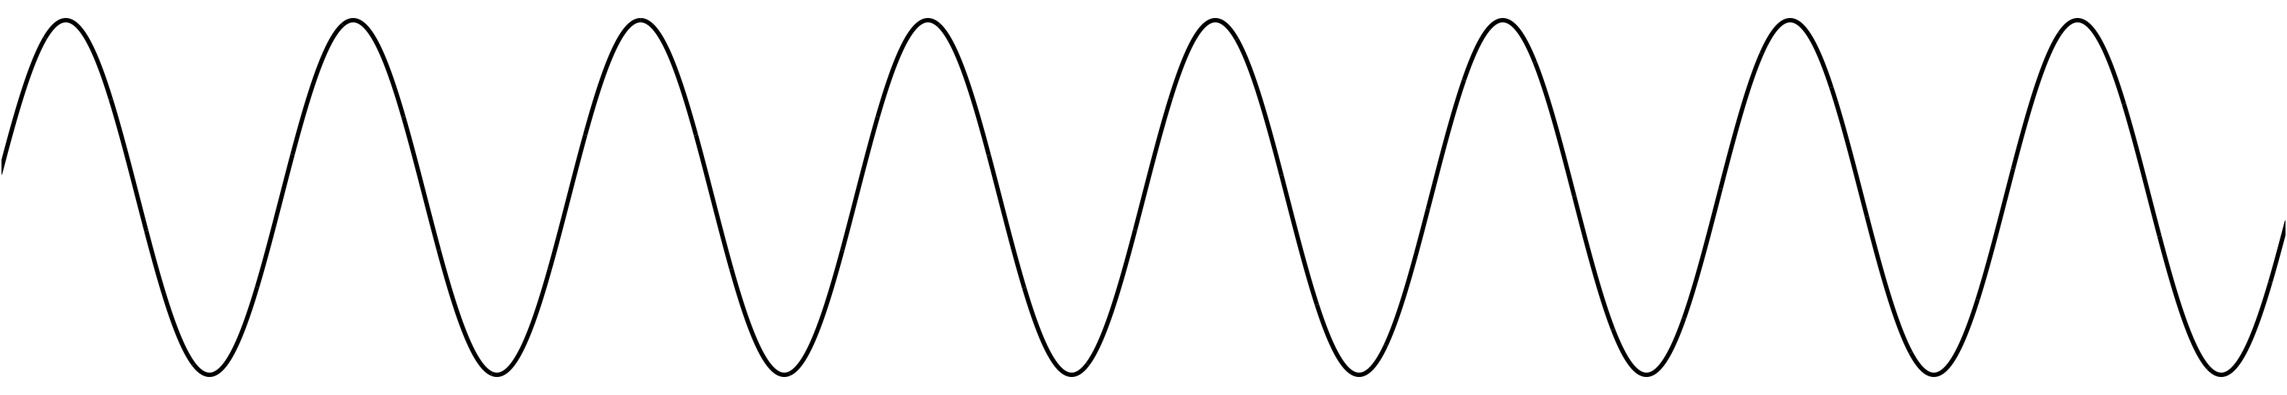
Robotisation
Simple phase vocoder effect to create robot-like voices
At each hop, set phase of every bin to 0
But preserve magnitude of bin, preserving shape of spectrum
What does zeroing the phase do?
No phase change between hops
So hops always advance by an integer number of cycles
Thus period of every bin must be integer division of hop size and frequency of each bin must be multiple of hop frequency fs/H
→robotisation effect imposes constant pitch determined by hop size
...
y[n]

Slide 3
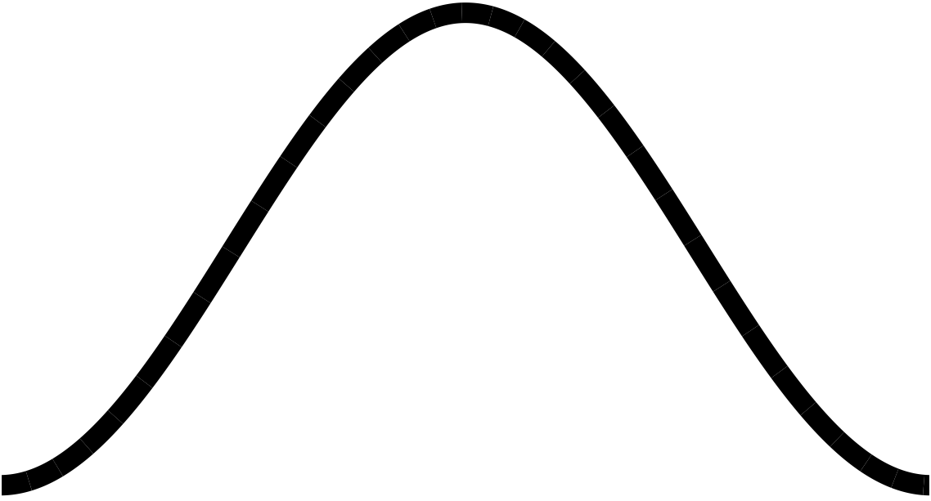
Robotisation
For cleanest effect, apply both analysis and synthesis windows
Analysis window smooths edges of each block coming into effect
But changing phase will scramble shape of block, so synthesis window needed to smooth edges again
Task
Implement Hann window for analysis and synthesis
Can calculate window once in setup() and use same array for analysis and synthesis
Multiply block by window in process_fft()
How does window change the sound?
Make hop size adjustable in GUI
FFT
zero phase
IFFT

Slide 4
Revisiting robotisation
Robotisation effect worked by setting all phases to 0 each hop
The fundamental frequency of the effect was fs/H
fs is the sample rate, H is the hop size
For example, fs = 44100, H = 256 yields a base frequency of 172Hz
Limitation 1: H must be an integer
This means the frequency can’t be finely tuned
Limitation 2: H typically doesn’t meet COLA criterion
It’s not an integer division of the FFT size
Non-COLA isn’t big deal since we don’t need exact reconstruction
Limitation 3: can’t do other frequency transformations at the same time
Other phase vocoder effects will assume a more regular hop size
It’s computationally expensive to run two simultaneous overlap-add FFT processes

Slide 5
Revisiting robotisation
How else could we achieve robotisation effect?
Manipulate the frequency components with the phase vocoder
The pitch shifter used a magnitude-frequency representation of the signal
The hard part was calculating that representation (and getting back again)
The pitch shift itself was simple: multiply by a constant
Let’s use the same magnitude-frequency representation for robotisation
Round each frequency to the nearest integer multiple of the desired fundamental
Keep the magnitudes of each frequency component constant
frequency
component
f
rounded frequency
component
×
round to integer
×
fr
fundamental
frequency
ff
1/x
skip if fr = 0 or fr > fs/2

Slide 6
Revisiting robotisation: task
Our previous projects expressed frequency in fractional bin numbers
Here, it may be easier to think about actual (discrete time) frequency
In discrete time, frequency ranges from 0 to 2π (corresponding to the sample rate)
We need to rescale our target fundamental frequency by multiplying by 2π/fs
Task: in project fft-robotisation-v2
Round the frequency of each bin to a multiple of the target fundamental
Remember that the rounded frequency might be in a different FFT bin
Keep magnitudes of each frequency component the same
frequency
component
f
rounded frequency
component
×
round to integer
×
fr
fundamental
frequency
ff
1/x
skip if fr = 0 or fr > fs/2

Slide 7
Improving the robotisation effect
You might have heard some artefacts
Frequency components glide smoothly up and down in the original signal
Now, they jump from one harmonic to another
The result is a trill-like effect
Alternative approach: interpolation
For each frequency component, generate energy at harmonics above and below
Scale the magnitude of the upper and lower harmonics depending on which harmonic is closer to the original frequency
This is a form of linear interpolation (see Lecture 3 for more)
Task: in fft-robotisation-v2, implement linear interpolation
Create two synthesis frequencies for each analysis frequency
Will often need to mix multiple components together in one FFT bin
rounded
original
frequency
fundamental
time

Slide 8
Robotisation VST I
int inwritepos; // Write pointer into the input buffer
int outwritepos; // Write pointer into the output (overlap-add) buffer
int outreadpos; // Read pointer into the output buffer
int inputBufferLength; // Length of the input buffer (in samples)
int outputBufferLength; // Length of the output buffer (in samples)
int sampsincefft; // Counter of how many samples have elapsed since last FFT
float *windowBuffer; // Buffer that holds the (pre-calculated) window function
int windowBufferLength; // Length of the window function
float *fftTimeDomain; // Buffer that holds time-domain samples for the FFT calculation
float *fftFrequencyDomain; // Buffer that holds frequency-domain samples from FFT
float fftScaleFactor; // Scaling factor to normalize output level; depends on window/hop sizes
int fftTransformSize_; // Size of the FFT calculation (in samples); normally equals
// window size but could be longer
int hopSize_; // Hop size parameter (in samples)
// Collect the audio samples in the input buffer. When we've reached the next
// hop interval, calculate the FFT and process the pitch shift.

Slide 9
Robotisation VST II
for (int i = 0; i < numSamples; ++i)
{
const float in = channelData[i];
// Store the next buffered sample in the output. Do this first before anything
// changes the output buffer-- we will have at least one FFT size worth of data
// stored and ready to go. Set the result to 0 when finished in preparation for the
// next overlap/add procedure.
channelData[i] = outputBufferData[outreadpos];
outputBufferData[outreadpos] = 0.0;
if(++outreadpos >= outputBufferLength) outreadpos = 0;
// Store the current sample in the input buffer, incrementing the write pointer. Also
// increment how many samples we've stored since the last transform. If it reaches
// the hop size, perform an FFT and any frequency-domain processing.
inputBufferData[inwritepos] = in;
if (++inwritepos >= inputBufferLength) inwritepos = 0;

Slide 10
Robotisation VST III
if (++sampsincefft >= hopSize_)
{
sampsincefft = 0;
// Find the index of the starting sample in the buffer. When the buffer length
// is equal to the transform size, this will be the current write position but
// this code is more general for larger buffers.
int inputBufferStartPosition = (inwritepos + inputBufferLength
- fftTransformSize_) % inputBufferLength;
// Window the buffer and copy it into the FFT input
int inputBufferIndex = inputBufferStartPosition;
for(int fftBufferIndex = 0; fftBufferIndex < fftTransformSize_; fftBufferIndex++)
{
// Set real part to windowed signal; imaginary part to 0.
fftTimeDomain[fftBufferIndex][1] = 0.0;
if(fftBufferIndex >= windowBufferLength) // Safety check, in case window
// isn't ready
fftTimeDomain[fftBufferIndex][0] = 0.0;
else
fftTimeDomain[fftBufferIndex][0] = windowBuffer[fftBufferIndex]
* inputBufferData[inputBufferIndex];
inputBufferIndex++;
if(inputBufferIndex >= inputBufferLength)
inputBufferIndex = 0;
}

Slide 11
Robotisation VST IV
// Perform the FFT on the windowed data, going into the frequency domain.
// Result will be in fftFrequencyDomain
fftw_execute(fftForwardPlan_);
// ********** PHASE VOCODER PROCESSING GOES HERE **************
// This is the place where frequency-domain calculations are made
// on the transformed signal. Put the result back into fftFrequencyDomain
// before transforming back.
// ************************************************************
for(int bin = 0; bin < fftTransformSize_; bin++)
{
float amplitude = sqrt(fftFrequencyDomain[bin][0]*fftFrequencyDomain[bin][0]
+ fftFrequencyDomain[bin][1]*fftFrequencyDomain[bin][1]);
// Set the phase of each bin to 0. phase = 0 means the signal is entirely
// positive-real, but the overall amplitude is the same as before.
fftFrequencyDomain[bin][0] = amplitude;
fftFrequencyDomain[bin][1] = 0.0;
}
// Perform the inverse FFT to get back to the time domain. Result wll be
// in fftTimeDomain. If we've done it right (kept the frequency domain
// symmetric), the time domain resuld should be strictly real allowing us
// to ignore the imaginary part.
fftw_execute(fftBackwardPlan_);

Slide 12
Robotisation VST V
// Add result to output buffer, starting at current write position
// (Output buffer will have been zeroed after reading last time around)
// Output needs to be scaled by transform size to get back to original amplitude.
// This is property of how fftw is implemented. Scaling will also need to be adjusted
// based on hop size to get same output level (smaller
// hop size produces more overlap and hence higher signal level)
int outputBufferIndex = outwritepos;
for(int fftBufferIndex = 0; fftBufferIndex < fftTransformSize_; fftBufferIndex++)
{
outputBufferData[outputBufferIndex] += fftTimeDomain[fftBufferIndex][0] * fftScaleFactor;
if(++outputBufferIndex >= outputBufferLength) outputBufferIndex = 0;
}
// Advance write position within the buffer by the hop size
outwritepos = (outwritepos + hopSize_) % outputBufferLength;
}
}

Slide 13
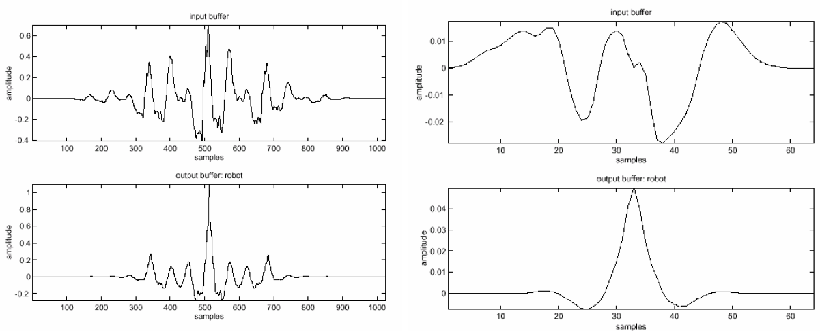
Robotisation
Window size affects performance
Use short window to capture just one period of waveform per segment
Left: M = 1024; Right: M = 64

Slide 14
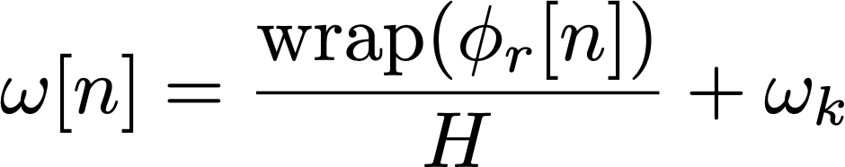
Whisperisation
Simple phase vocoder effect to obscure the pitch of a sound
On speech, it can produce a whisper-like effect
At each hop, randomise phase of each bin
This means difference in phase between hops is also randomised
Therefore frequency of bins is also randomised (within range)
How much frequency variation can whisperisation introduce?
Phase difference between hops must be in the range ±π
How much difference is that? Recall:
So frequency of each bin could differ by up to ±π/H
Smaller hop sizes allow more frequency variation
As with robotisation, analysis and synthesis windows improve effect
Smaller FFT size might produce more convincing effect

Slide 15
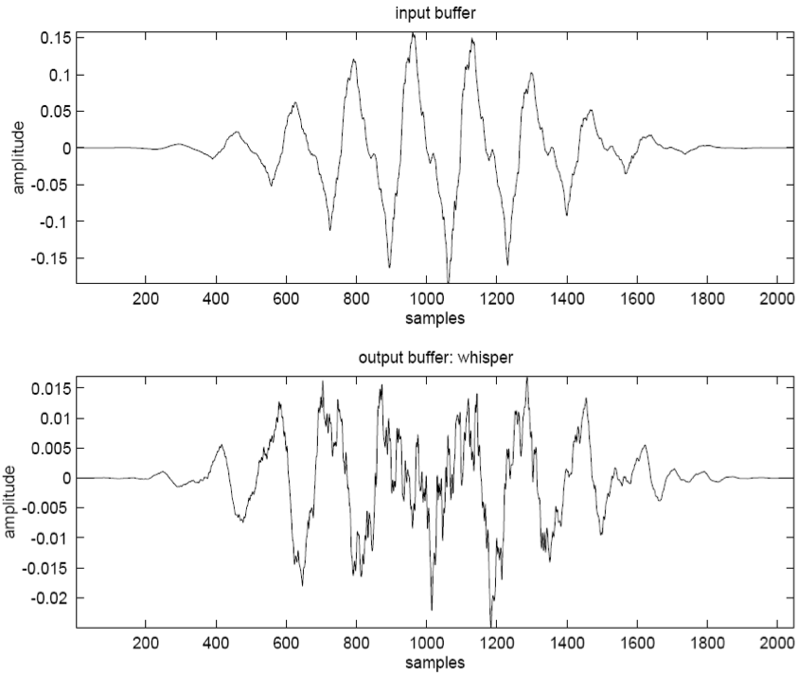
Whisperisation
Whisperisation = erasing pitch cues
Implemented by randomising DFT phases before reconstruction
Short window lengths work best

Slide 16
Whisperisation VST
adapt previous robotization code example to perform whisperization
basic overlap-add structure stays
only need to change lines following FFT calculation
int for(int bin = 0; bin <= fftTransformSize_ / 2; bin++)
{
float amplitude = sqrt(fftFrequencyDomain[bin][0]*fftFrequencyDomain[bin][0] +
fftFrequencyDomain[bin][1]*fftFrequencyDomain[bin][1]);
// This is what we would use to exactly reconstruct the signal:
// float phase = atan2(fftFrequencyDomain[bin][1], fftFrequencyDomain[bin][0]);
// Instead, use this to scramble phase:
float phase = 2.0 * M_PI * (float)rand() / (float)RAND_MAX;
// Set phase of each bin to 0. phase = 0 means signal entirely positive-real,
// but overall amplitude same as before.
fftFrequencyDomain[bin][0] = amplitude * cos(phase);
fftFrequencyDomain[bin][1] = amplitude * sin(phase);
// FFTs of real signals are conjugate-symmetric. We need to maintain that symmetry
// to produce a real output, even as we randomize the phase.
if(bin > 0 && bin < fftTransformSize_ / 2) {
fftFrequencyDomain[fftTransformSize_ - bin][0] = amplitude * cos(phase);
fftFrequencyDomain[fftTransformSize_ - bin][1] = -amplitude * sin(phase);
}
}

